Slide 1
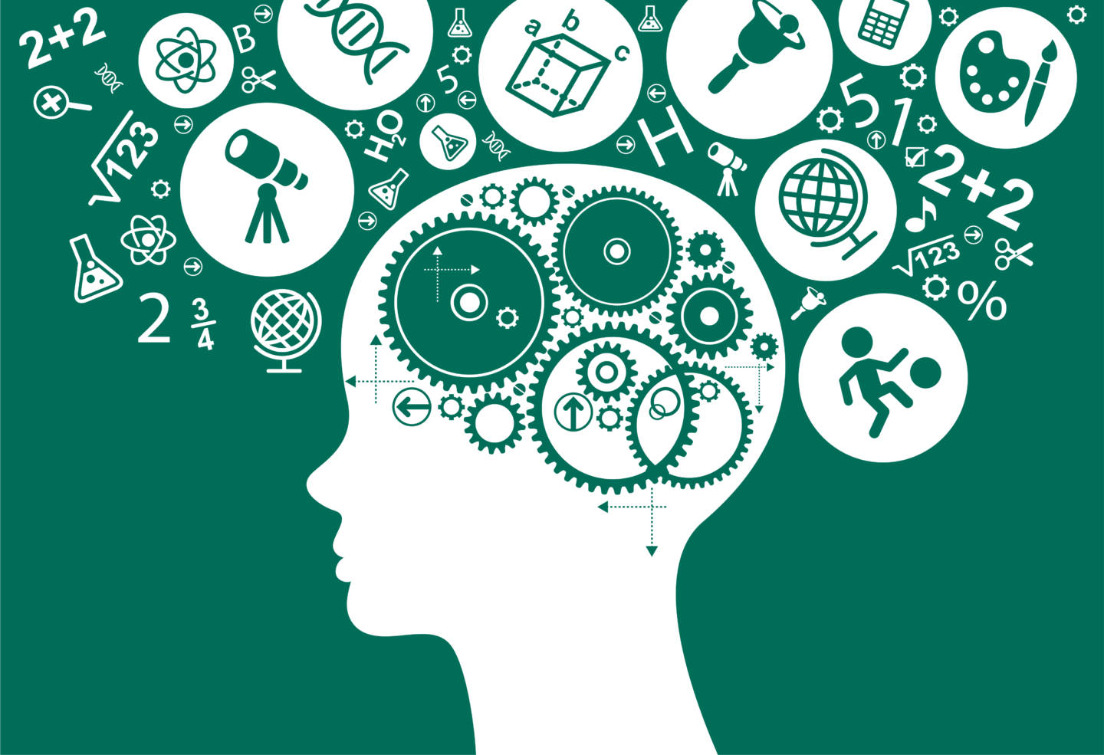
EXPLORING THE IMPORTANCE OF COMPUTATIONAL & ANALYTICAL SKILLS IN HIGH SCHOOL - FOR COLLEGE READINESS AND STEM CAREERS
Refer to Notes in PPT for details
Priya Malhotra
Junior, Liberal Arts & Science Academy (LASA)
Founder/President Research in Math Club
http://LASARimClub.wordpress.com
Contact: PriyaTX@gmail.com
Notes:
SLIDE 1 – TITLE SLIDE
Good afternoon and welcome to my presentation. Today I am going to share the skills I think are important to learn today for STEM careers, how to help students learn this skills, and specifically how to encourage girls in high schools to develop these skills – based on my personal experience and as a high school student.
A little bit about me: I am a Junior at LASA, the Liberal Arts and Science Academy, in Austin. It is a magnet school for humanities and science. I am focusing on STEM and want to become a computational engineer. At LASA, I have opened a club – for Research in Math – that focuses on getting college-level research experience at high school. This club is mentored by a UT professor of math, Dr. Rachel Ward. I also volunteer often at Thinkery, which is a Children’s Science Museum in Austin.
With this brief introduction of me, let me jump into my presentation.

Slide 2
Introduction
Adaptable skills are critical. 85% of jobs in 2030 have not been invented yet.*
Need for analytical and computational skills will grow, especially in STEM careers
Helping students develop such skills needs a disciplined approach
Ethics and economic efficiency dictate that any career (esp. STEM) needs to become gender-neutral
* https://www.huffingtonpost.ca/2017/07/14/85-of-jobs-that-will-exist-in-2030- haven-t-been-invented-yet-d_a_23030098/ (IFTF estimate)
* https://www.weforum.org/agenda/2016/06/10-jobs-that-didn-t-exist-10-years-ago/
Notes:
SLIDE 2
I am sure we have all seen or read about how jobs evolve. The only constant is that they are changing all the time. Some jobs that existed a decade ago (for example, travel agents) now hardly exist. Other jobs, such as an Artificial Intelligence researcher, were unimaginable a decade ago. So it is very important to have skills that can adapt to any job. One estimate by Dell and IFTF (Institute for the Future) estimates that 85% of jobs in 2030 don’t even exist yet – which means that we can’t even imagine what it would be like to work in 2030! How do we prepare for careers that we can’t even imagine! And it is not that human beings will be replaced by machines. It’s just that we will do completely different things.
If you think that 85% estimate is an exaggeration, just think that Facebook & Twitter did not exist 15 years ago. Now companies are dumping entire groups of conventional marketing groups, and hiring digital marketers who specialize in social media. How do we learn how to consistently stay relevant in such a world of constant change?
Twitter is eliminating the need for conventional news outlets. How could someone future-proof their job?
Taxi drivers got replaced by Uber drivers (who are not professional drivers), only to be replaced one day by nothing, which is “driver-less” cars. What will be next – teleporting? We may soon realize that the movie “The Fly” was not just science fiction, but perhaps even science?
Even Hollywood movie stars could get replaced by computer graphics by 2050. CGI researchers could one day be able to create emotion by graphics. Is anyone really safe?
All of this leads to one conclusion – Acquiring skills that can adapt to *any* job are very important. Specifically, analytical and computational skills are very important, and even more so in STEM. The right time to develop these skills is “as soon as possible”, which would be in school itself.
And we must make sure that these skills cut across gender, and everyone – men or women – are equally trained with these skills to do any job.

Slide 3
Skills hierarchy
Language & Comprehension
Early language development
Early Reading, Writing, & Comprehension
Analytical and Computational Skills
Early, Strong foundations in Math
Hands-on Science activities
Leadership
Cross-functional critical thinking
Soft skills
Metacognition: Think about how you think
Critical Thinking
Notes:
SLIDE 3
Looking at the entire range of skills, Language and Comprehension are most basic. Reading & Writing of course are fundamental. Being able to comprehend what is being read or said is of course a necessity. And one cannot imagine success without the ability to think critically. Without these skills, nothing else is possible.
Some people say that learning one language in future will be enough, because Google will translate everything real-time. Perhaps so, although benefits to brain of learning multiple languages has been proven already.
Then comes analytical and computational skills. We will see in next slide what these skills mean. For example, math fundamentals will always remain important. Performing scientific activities to get a good grasp of science will always be important. Learning how to use math to pretty much solve or simplify any quantifiable problem is important, and now classified under “computational engineering.”
And finally, being able to think across all functions and being able to lead is the next step in skills development - however, this comes with experience. This also includes emotional and social intelligence. But I don’t plan to delve into soft skills today.

Slide 4
What skills to develop?
Analytical
Computational
Understand “big picture”
Identify goals, hindrances, possible solutions, and pros/cons
Respect different points-of-views
Applicable to any field, not just STEM
Using logic to define and solve a problem
Built on solid understanding of math
Be able to apply basic or advanced math concepts (Algebra, Probability, Statistics, Differential Equations, Linear algebra, etc.)
Encourage students: “Think about how you think”
Notes:
SLIDE 4
Analytical and computational skills have an overlap. But there are key differences. Analytical skills are more generic. Making sensible decisions with the given information is an analytical skill. It means the ability to look at a problem and understand: what are we trying to achieve, what is the issue, what are the possible solutions, and how do we compare various solutions. These skills are needed in any field, whether a political challenge or a scientific challenge.
Analytical skills are needed in any field. It is the basic capability to solve problems.
Computational skills are more quantitative in nature. Can I define the solution in a logical way? Can I define the solution in a step-by-step method? How can I use basic or advanced math to solve these problems? Computational skills are needed in many fields - such as when trying to predict stock market movements, or perform an actuarial task, or trying to determine to how to redesign the wings of a plane for more fuel efficiency, less noise, and more safety. Usually these skills are more associated with math, but these should be associated with logic as well.
We should encourage students to ask meaningful questions and teachers should check their understanding of the concept during the discussion. Teachers need to give Positive Feedback for all interesting classroom discussions. Why? Because this will lead to a better understanding of the concepts. It will lead to solidifying the student’s skills and interests in computational and analytical areas of learning.
Those who ask questions in class should be respected, not ridiculed

Slide 5
How to develop required skills?
Teach students to think early
Consistent, Early brain training → Better decision-making in future
Encourage them to ask questions
Provide positive feedback
Practice! Practice! Practice!
Foundation (esp. math) built on persistent hard work
Hands-on activities
Litmus test: “Can students teach what they learn?”
Notes:
SLIDE 5
A disciplined approach is needed to develop these skills. One is not born with these skills, so they must be learnt or taught. Anyone can be trained to have these skills.
The earlier we teach these skills, the better it is because the brain is more open to input at a younger age.
Encouraging students to ask questions is key – because asking questions implies that that one needs to think. Thinking is fundamental to everything.
Feedback mechanism helps students gain confidence that they are asking the right question.
Practice is essential to any success, including any skill development. The more one does, the more one learns, and the more it gets ingrained in mind and becomes a habit. Especially math, which comes primarily with practice.

Slide 6
Encourage girls in STEM
Ensure participation in math, robotics, and science extra-curricular and teams: Opportunity and frequency is critical
Identify self-motivated vs. teacher-encouraged learning styles, and adapt
Provide choice: co-educational vs. girls-only teams
Invite role models
Recognize achievement publicly
Introduce STEM careers early
Notes:
SLIDE 6
And now to the part that is more relevant to this summit. All of these skills we discussed are applicable to any human – men and women. But given the social conditioning, the teachers must provide extra encouragement to girls to participate in extracurricular STEM activities, whether it is a robotics club, or a science competition, or a math tournament. Participation emphasizes learning. It also implies practice. Participation is always hands-on. Science is easier to learn when it is more hands-on. Different students have different learning styles – some like structure, others are more creative when left alone. Some girls are more comfortable with STEM in girls-only clubs, others don’t care. Teachers must understand various styles, and create better environment for girls to succeed.
Teachers can identify students early who are strong in math, especially girls. When girls teach their peers, they also become more confident and such confidence is necessary for both computational and analytical skills.
For example, starting when I was in 6th grade, my math teacher would often send kids my way when they needed help in math problems. And by teaching them the concepts, my confidence in my STEM abilities grew, and both I and the students I was teaching understood the concepts better.
An exposure to Role Models is another key to girls’ success. When you see someone like you who can overcome barriers, one starts to visualize success. That is the first crucial step to becoming successful.
These Role Models can inspire many young girls into believing and understanding that STEM can also be a path for them. Many girls do not feel comfortable going into STEM because they just have not seen other women go into the field and believe that STEM careers are only for men. When they see more women that they respect in STEM careers, they can start to understand that STEM careers are also a possibility for them as well.
Teachers can help increase the confidence of girls by publicly acknowledging their efforts and results. This helps to increase their confidence. And finally, introduce STEM careers early – the sooner the better. This helps them visualize what they can become one day!

Slide 7
Encourage girls’ in Math
Start early – Basic concepts are critical
Math skills develop over time
Overcoming middle-school hump is important
“Visualize math” - Mental math is key
Expand beyond textbook math
Math is basis for many careers
E.g. Multi-disciplinarian Computational Engineering built on mathematical algorithms
Notes:
SLIDE 7
Same goes for math – one must start early and start enjoying math. Practice is key – the more time the girls spend to develop math concepts, the better it is. Math should be ingrained from early on. Sometime in middle school – I have seen – some girls start to dislike math. This should be avoided by focusing on math from early on. If math skills development has started early, the chances of continuing with math become higher.
“Visualizing” math is also important. For this, one has to be able to do basic math in mind. This also comes with practice. It makes girls think in a different way – and they always find an efficient solution that works for them. For example, if you can visualize math, then you know that 132 – 95 is same as 32+5 = 37. No more carrying and the complicated subtraction stuff. There are many different ways to solve a problem mentally and students show real creativity in this case.
Math is important because it forms the basis of so many different careers, not to mention the day-to-day basic math that is needed and is better done mentally (without pen and paper)
STEM careers are not to be taken lightly. With new advanced technological changes, we are in need of a very strong workforce for the future who are efficient at computational and analytical skills and they will become our future engineers and innovators.

